Slide 1
Cellebrite UFED Premium
Sofia Sackett
Cfrs 510 spring 2020
19 march 2020

Slide 2
Cellebrite
Digital intelligence for a safer world

Slide 3
Cellebrite
Israeli forensics firm and law enforcement contractor
North American HQ in New Jersey
Owned by Japan’s Sun Corporation

Slide 4
UFED Background
Originally sold to mobile phone retailers to transfer existing phone data to newly purchased phones
Used to be called the Universal Memory Exchanger (UME 36)
Law enforcement saw the UME’s forensic potential
UFED Touch for on-site extractions
UFED 4PC for workstations

Slide 5
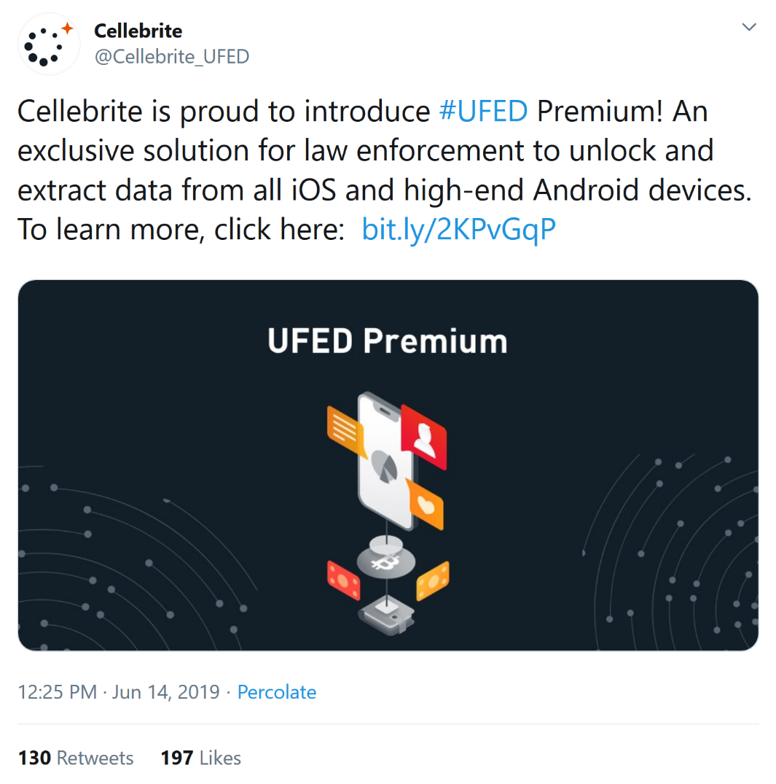
Cellebrite UFED Premium
06/14/2019: announced UFED Premium
Able to unlock most iOS devices and many high-end Android devices
Utilizes the checkm8 exploit
https://twitter.com/Cellebrite_UFED/status/1139569499206643715

Slide 6
UFED Premium
Unlock and file system extraction

Slide 7
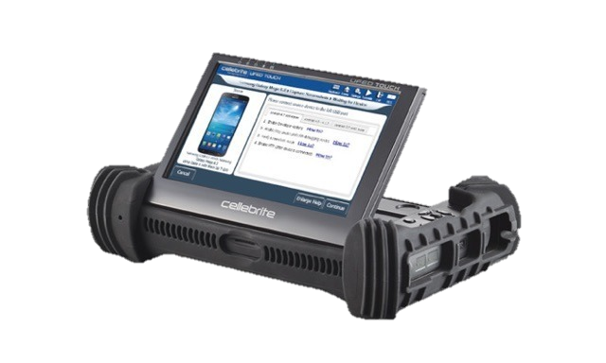
Capabilities
Unlocks and extracts mobile evidence from iOS and Android phones
Can bypass or determine locks
iOS: Full file system extraction
Android: full file system or physical extraction
https://photos5.appleinsider.com/gallery/24958-33184-20037-21286-cellebritetool1-l-l.jpg

Slide 8
Logical
File System
Physical
Quickest and easiest
Least invasive
Messaging
Contacts
Call logs
App data
Media
Same as logical but also includes:
Documents (.txt, .pdf)
Hidden files that provide info about the file system
Most comprehensive
Most invasive
Includes everything as well as unallocated space

Slide 9
Types of 3rd Party App Data
Chat conversations
Emails and email attachments
Deleted content
Calendar data
Call logs
Contacts

Slide 10
What Else Can UFED Do?
Analysis and report generation
Creates a chronological order of events
Can recover deleted image files and fragments
Export content to SQL database files
Uses Python for content decoding
Can import your own Python scripts

Slide 11
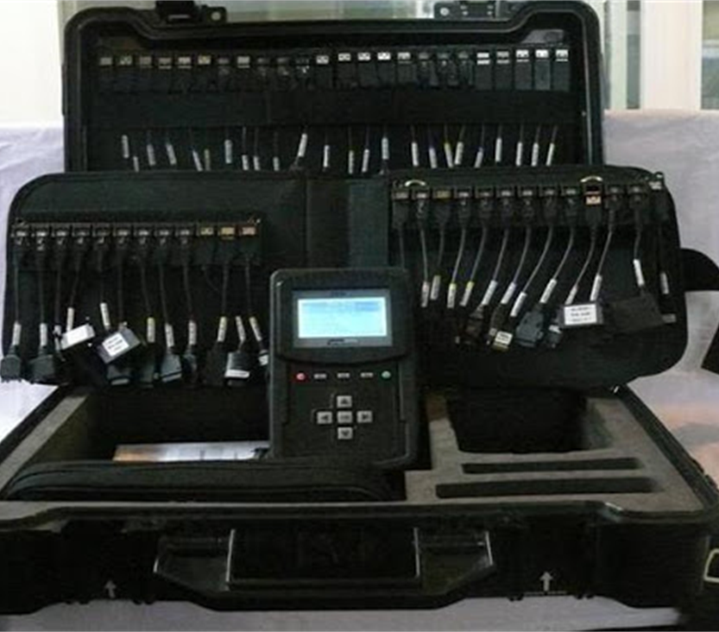
Support
Android up to Android 10
Samsung
Motorola
LG
Huawei
Sony
Nokia
iOS 7 to 13.3.x
iPhone 5S and newer
5th generation iPod touch and newer
iPad mini, iPad 2 and newer
http://www.itechdataforensics.com/cellebrite.html

Slide 12
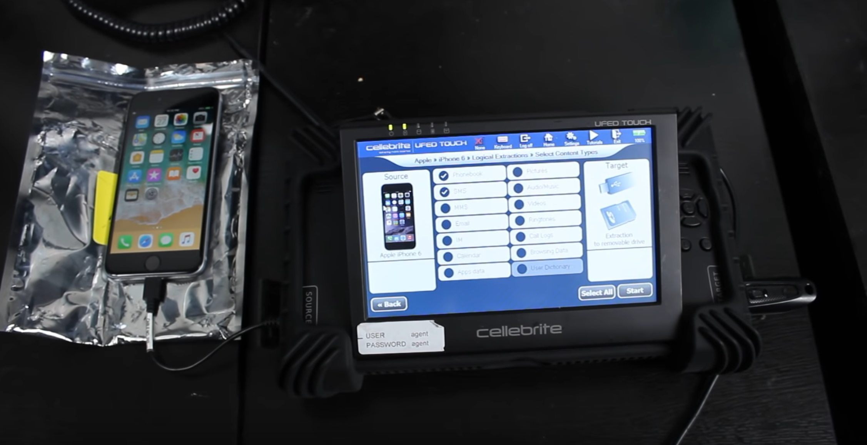
https://www.youtube.com/watch?v=tj5acVAJgjk

Slide 13
Checkm8 Exploit
Hijacking the ios bootrom

Slide 14
Exploit Overview
09/2019: Security researcher axi0mx released the checkm8 boot ROM exploit
Affects devices that run on A11 or earlier chips
Could affect hundreds of millions of phones currently in use
Allows for a full file system extraction
Passwords
Keys
Tokens

Slide 15
Why You Shouldn’t Worry
Checkm8 is a tethered exploit, meaning that there are no persistence mechanisms in place
There is no remote execution possibility
It does not compromise the Secure Enclave
Requires the phone to be jailbroken first

Slide 16
How Does Checkm8 Work?
Each step of Apple's startup process has components that are signed by Apple
Checkm8 exploits a flaw at the very beginning of this process
Targets the iOS boot ROM
Cannot be patched through a software update

Slide 17
Apple Secure Boot Chain
Public Key
iBoot
Kernel
iOS
Boot ROM
Low-Level Bootloader (LLB)
App Processor
✔
✔
✔
✔
Checkm8 Exploit
Public Key
iBoot
Kernel
iOS
Boot ROM
Low-Level Bootloader (LLB)
App Processor
?
?
?
?
https://developer.apple.com/videos/play/wwdc2016/705

Slide 18
Checkm8 and Cellebrite
Checkm8 alone was not particularly impactful
Required phone to be jailbroken; less forensically sound
Needed 3rd party tool checkra1n
Had to use a macOS workstation
Multiple stages and error prone
UFED Premium fully integrated the checkm8 exploit

Slide 19
Legality Discussion
Is Cellebrite data admissible in court?
Proprietary process and code may be cause for concern
How can they prove that they did not plant evidence?
Washington v. State of Texas (2015)
Appealed charge based on unreliability of Cellebrite data
Judge decided Cellebrite was still valid
Defense argued that UFED should be treated the same as a breathalyzer

Slide 20
Equating UFED with Intoxilyzer
Prove that machine was functioning properly
Also prove that phone was functioning properly
User must be qualified to translate or interpret results
Periodic supervision by someone who understands scientific theory of the machine

Slide 21
Questions?

Slide 22
References
Checkm8 Exploit
https://www.sentinelone.com/blog/checkm8-5-things-you-should-know-new-ios-boot-rom-exploit/
https://arstechnica.com/information-technology/2019/09/developer-of-checkm8-explains-why-idevice-jailbreak-exploit-is-a-game-changer/
https://www.theverge.com/2019/9/27/20886835/iphone-exploit-checkm8-axi0mx-security-flaw-vunerability-jailbreak-permanent-bootrom-ios
https://developer.apple.com/videos/play/wwdc2016/705
Cellebrite
https://www.cellebrite.com/en/ufed-premium/
https://www.wired.com/story/cellebrite-ufed-ios-12-iphone-hack-android/
https://www.youtube.com/watch?v=tj5acVAJgjk
https://www.scmp.com/tech/enterprises/article/3046117/iphone-hacking-firm-updates-digital-forensics-tool-after-apple
https://www.cellebrite.com/en/about/company/
https://www.detective-store.com/ufed-ultimate-license-1-year-461.html
https://www.cellebrite.com/en/webinars/checkm8-and-checkra1n-full-filesystem-extractions-for-ios-devices/
https://www.cellebrite.com/en/blog/a-practical-guide-to-checkm8/
Quentin Washington v. State of Texas
https://cases.justia.com/texas/second-court-of-appeals/2015-02-13-00526-cr.pdf?ts=1423217506

